Slide 1
Future of the Plainfield Coop
Summary of Findings from the USDA Rural Business Development Grant and discussion of options

Slide 2
Agenda
6:30pm. Purpose of Meeting and Introductions
6:45pm. Background on the Issue
7:00 pm. The Options Explained.
7:10pm. Voting Explained
7:15pm. Clarifying Questions about the Options.
7:30pm. Sharing Your Thoughts.
8:30pm. Wrap-Up

Slide 3
Process
Grant results and information is posted on the coop website
2 informational meetings (in-person and Zoom)
Annual Meeting on August 27th at 4 pm at the Rec Field
Members will be asked to vote on whether or not we should move forward with a plan to purchase Plainfield Hardware and move operation to that location.
2/3rd majority of votes cast are required to approve a real estate change
Voting will take place by paper ballot available at the Annual Meeting and will remain open for10 days afterwards with a ballot box located at the coop.

Slide 4
Background and History
What has changed?
Declining sales annually since 2019
Increased availability of natural food in multiple outlets (increased competition)
Inflationary costs and consolidation in industry resulting in high retail prices
Under investment in maintaining the building and in the business
Covid related grants and increased debt (accounts payable) have kept the business afloat

Slide 5
Considered four potential options
Stay in place, no major changes
Expand existing building by 660 sq ft (from 1200 sq ft of sales area to 1860 sq ft of sales area
Purchase Allenwood Stables and build a new building (3000 sq ft sales area)
Purchase Plainfield Hardware on Rt. 2 and move coop to that location
Grant results include a Market Study and Sales Projections, Architectural Study for Expansion and 10 year Financial Forecasts for 3 of these options

Slide 6
Updated Market Study
G2G Research Group updated the 2018 Market Study
Estimated future sales for two options
Expanded coop in current location with 1860 sq ft of sales area
Route 2 location with 3000 sq ft of sales area
Both estimates include increase in grab-and-go options. Sales for village location forecast to drop 12-17% in 2028 due to bridge closure.

Slide 7
Sales Forecast from Market Study
Expanded village location
2026= $1.32 million
2029= $1.48 million
Route 2 location
2026= $2.23 million
2029= $2.49 million

Slide 8
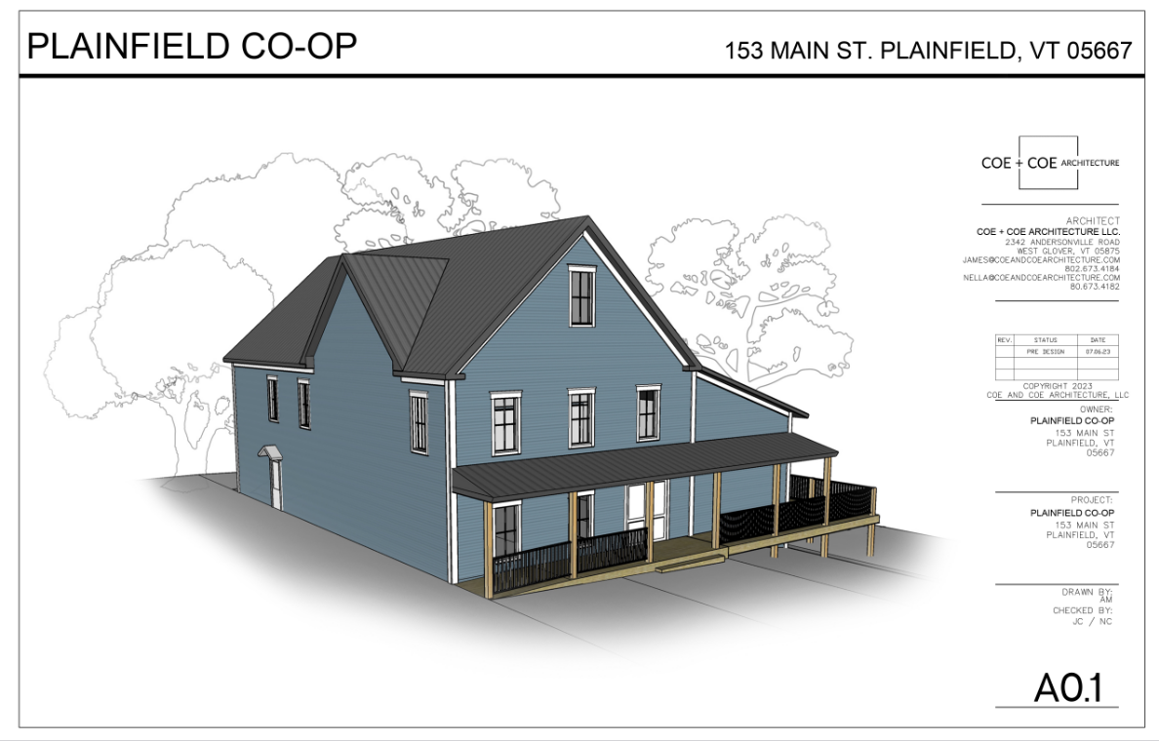
Architectural Study for Expansion
Code review, Cost Estimates and Schematic Design on coop website

Slide 9
Financial Analysis of options
Final report available on the coop website
10 year financial forecasts (pro formas) were created for the 3 feasible options
Templates for funding plans and further financial analysis were created that we can use going forward

Slide 10
Open Discussion of each option
Stay in place without expansion
Purchase Allenwood Stables
Expand at current location
Purchase Plainfield Hardware and move operations to that location

Slide 11
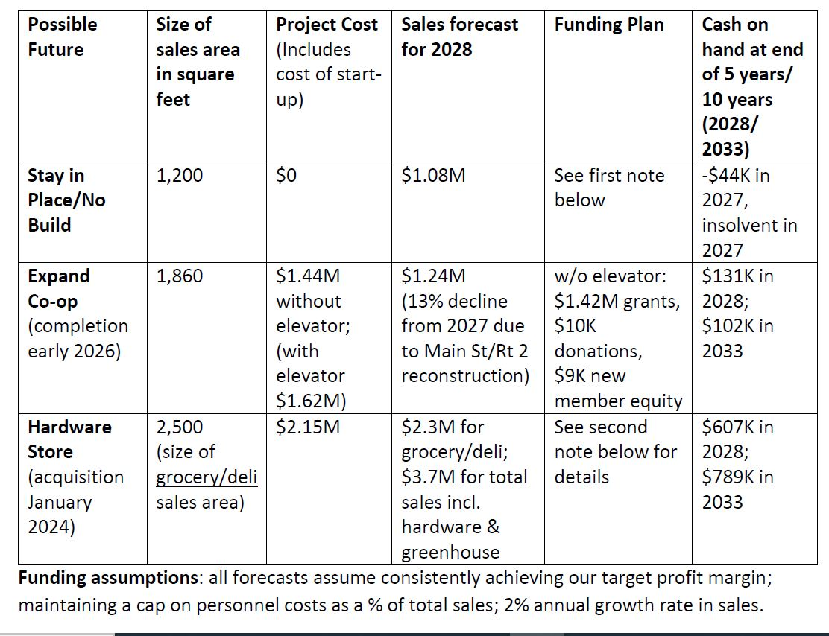

Slide 12
Ballot
Given that the current operations of the Co-op are not sustainable per extensive financial analysis, the Co-op Board is considering several options. One of these options is the purchase of Plainfield Hardware. All real estate decisions require a 2/3 majority, so this is being phrased as a yes/no vote.
I authorize the Plainfield Coop Board to explore financing and purchase options for the Plainfield Hardware Store with the intent of moving the operations of the Co-op to that location, maintaining the hardware store and expanding the grocery sales. If a purchase of that location is financially feasible, I authorize the Board to move forward with that purchase and incur the associated debt.
_____Yes
_____No

